Slide 1
Chapter 13
Business Intelligence and Data Warehouses

Slide 2
Learning Objectives
In this chapter, students will learn:
How business intelligence provides a comprehensive business decision support framework
About business intelligence architecture, its evolution, and reporting styles
About the relationship and differences between operational data and decision support data
What a data warehouse is and how to prepare data for one

Slide 3
Learning Objectives
In this chapter, students will learn:
What star schemas are and how they are constructed
About data analytics, data mining, and predictive analytics
About online analytical processing (OLAP)
How SQL extensions are used to support OLAP-type data manipulations

Slide 4
Business Intelligence (BI)
Comprehensive, cohesive, integrated set of tools and processes
Captures, collects, integrates, stores, and analyzes data
Purpose - Generate and present information to support business decision making
Allows a business to transform:
Data into information
Information into knowledge
Knowledge into wisdom

Slide 5
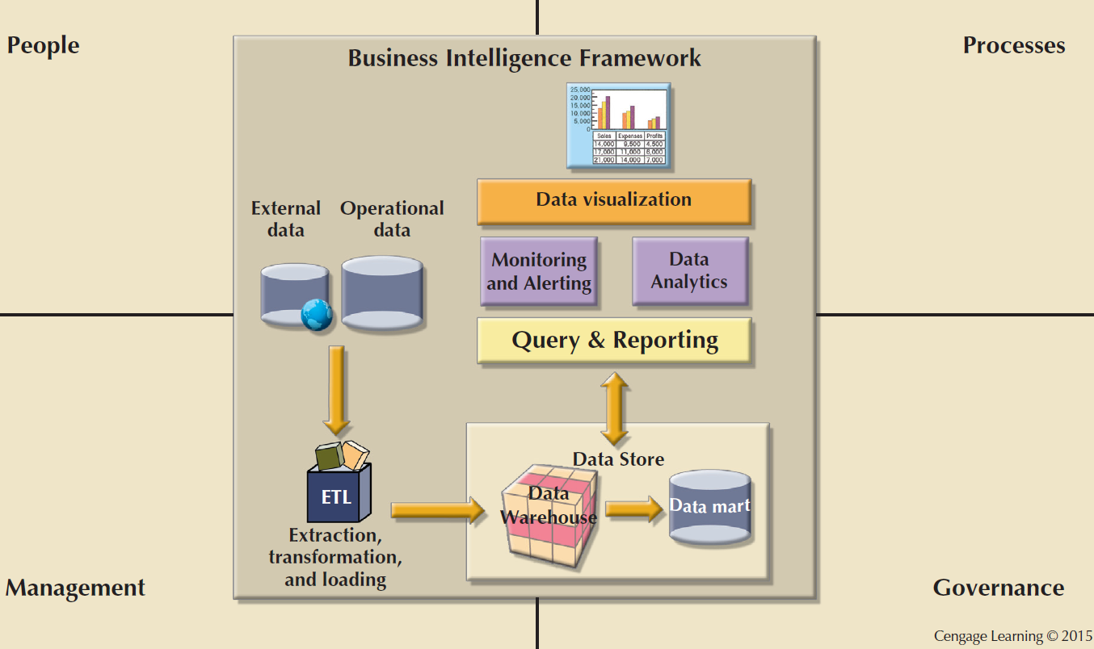
Figure 13.1 - Business Intelligence Framework

Slide 6
Business Intelligence Tools
Dashboards and business activity monitoring
Dashboards: Shows key business performance indicators in a single integrated view
Portals: Integrate data using web browser from multiple sources into a single webpage
Data analysis and reporting tools
Data-mining tools
Data warehouses (DW)
OLAP tools and data visualization

Slide 7
Practices to Manage Data
Master data management (MDM): Collection of concepts, techniques, and processes for identification, definition, and management of data elements
Governance: Method of government for controlling business health and for consistent decision making
Key performance indicators (KPI): Numeric or scale-based measurements that assess company’s effectiveness in reaching its goals

Slide 8
Practices to Manage Data
Data visualization: Abstracting data to provide information in a visual format
Enhances the user’s ability to efficiently comprehend the meaning of the data
Techniques
Pie charts and bar charts
Line graphs
Scatter plots
Gantt charts
Heat maps

Slide 9
Reporting Styles of a Modern BI System
Advanced reporting
Monitoring and alerting
Advanced data analytics

Slide 10
Business Intelligence Benefits
Improved decision making
Integrating architecture
Common user interface for data reporting and analysis
Common data repository fosters single version of company data
Improved organizational performance

Slide 11
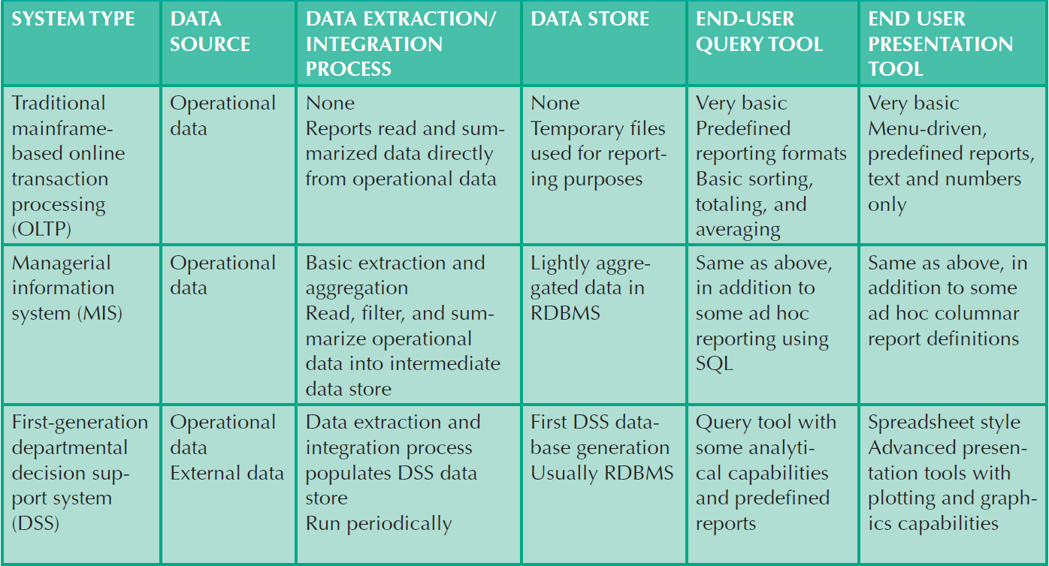
Table 13.4 - Business Intelligence Evolution
Cengage Learning © 2015

Slide 12
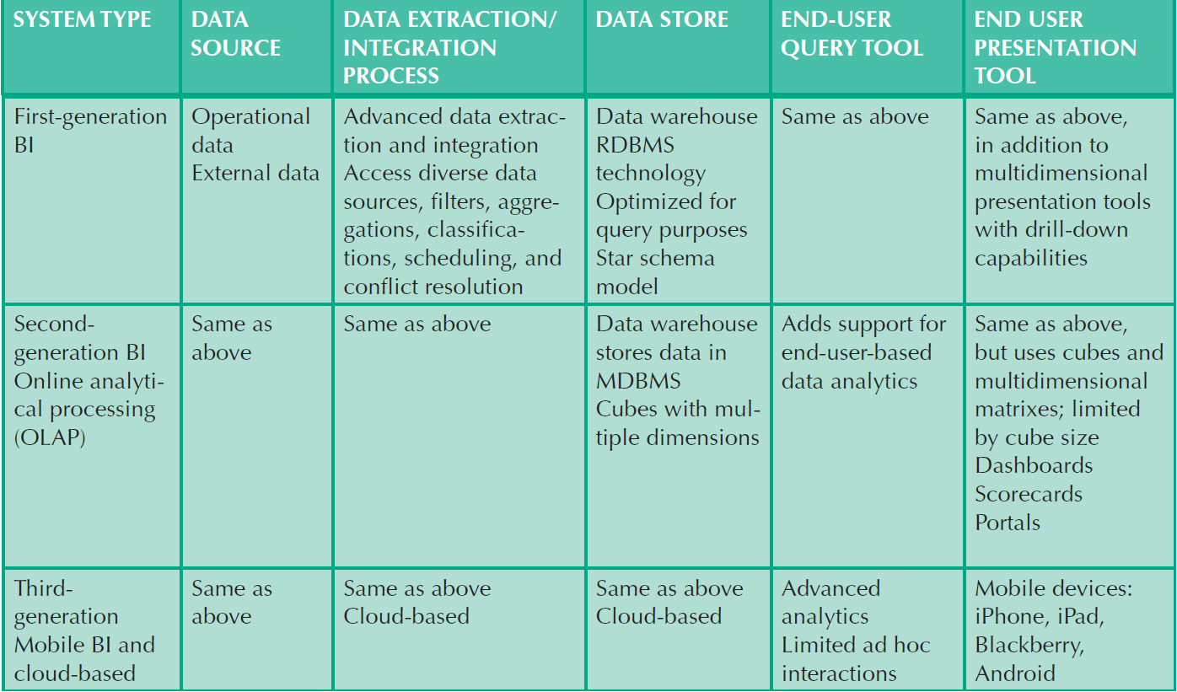
Table 13.4 - Business Intelligence Evolution
Cengage Learning © 2015

Slide 13
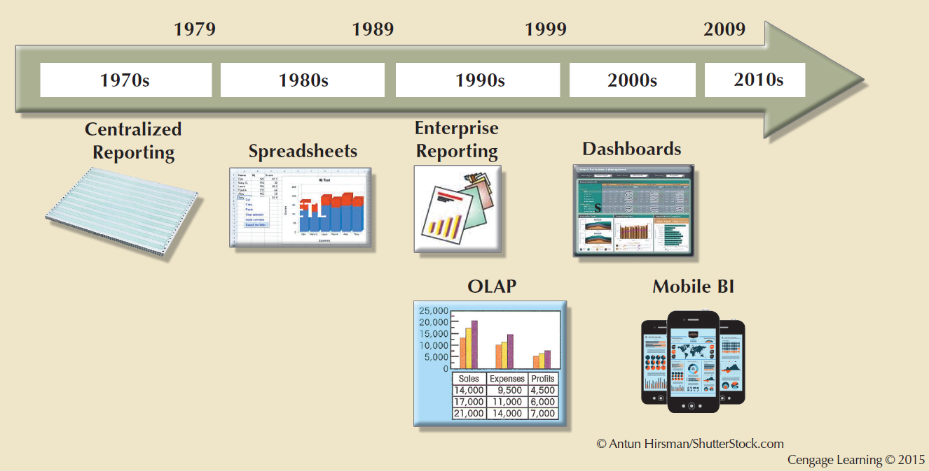
Figure 13.3 - Evolution of BI Information Dissemination Formats

Slide 14
Business Intelligence Technology Trends
Data storage improvements
Business intelligence appliances
Business intelligence as a service
Big Data analytics
Personal analytics

Slide 15
Decision Support Data
Effectiveness of BI depends on quality of data gathered at operational level
Operational data
Seldom well-suited for decision support tasks
Stored in relational database with highly normalized structures
Optimized to support transactions representing daily operations

Slide 16
Decision Support Data
Differ from operational data in:
Time span
Granularity
Drill down: Decomposing a data to a lower level
Roll up: Aggregating a data into a higher level
Dimensionality

Slide 17
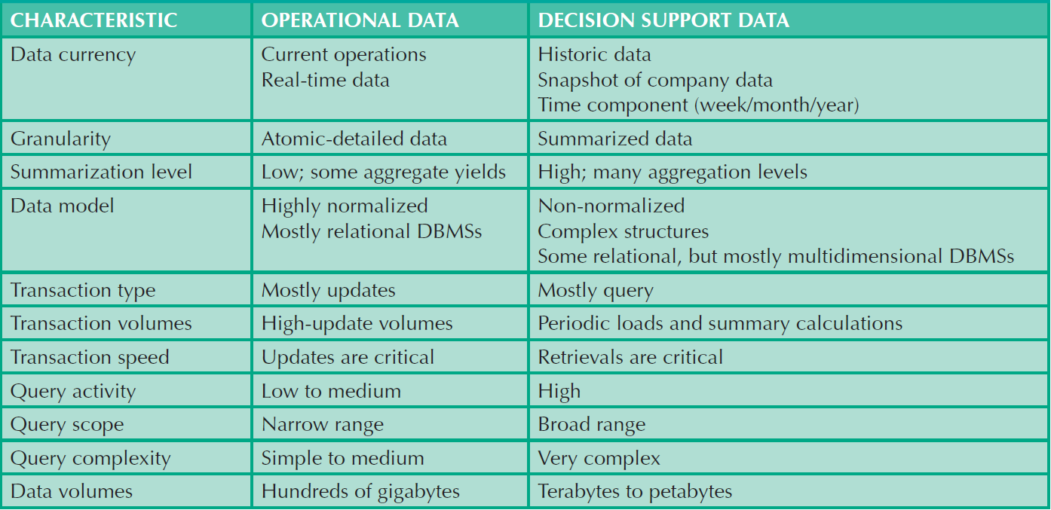
Table 13.5 - Contrasting Operational and Decision Support Data Characteristics
Cengage Learning © 2015

Slide 18
Decision Support Database Requirements
Database schema
Must support complex, non-normalized data representations
Data must be aggregated and summarized
Queries must be able to extract multidimensional time slices

Slide 19
Decision Support Database Requirements
Data extraction and loading
Allow batch and scheduled data extraction
Support different data sources and check for inconsistent data or data validation rules
Support advanced integration, aggregation, and classification
Database size should support:
Very large databases (VLDBs)
Advanced storage technologies
Multiple-processor technologies

Slide 20
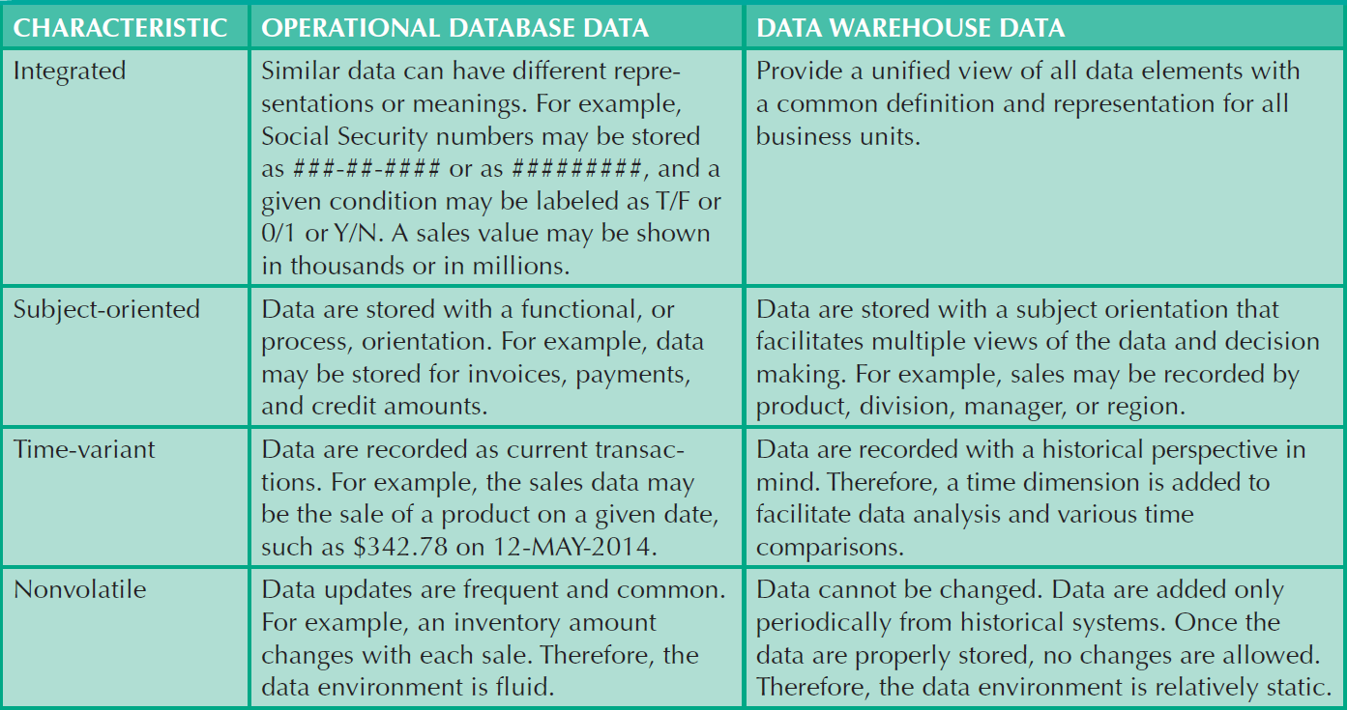
Table 13.8 - Characteristics of Data Warehouse Data and Operational Database Data
Cengage Learning © 2015

Slide 21
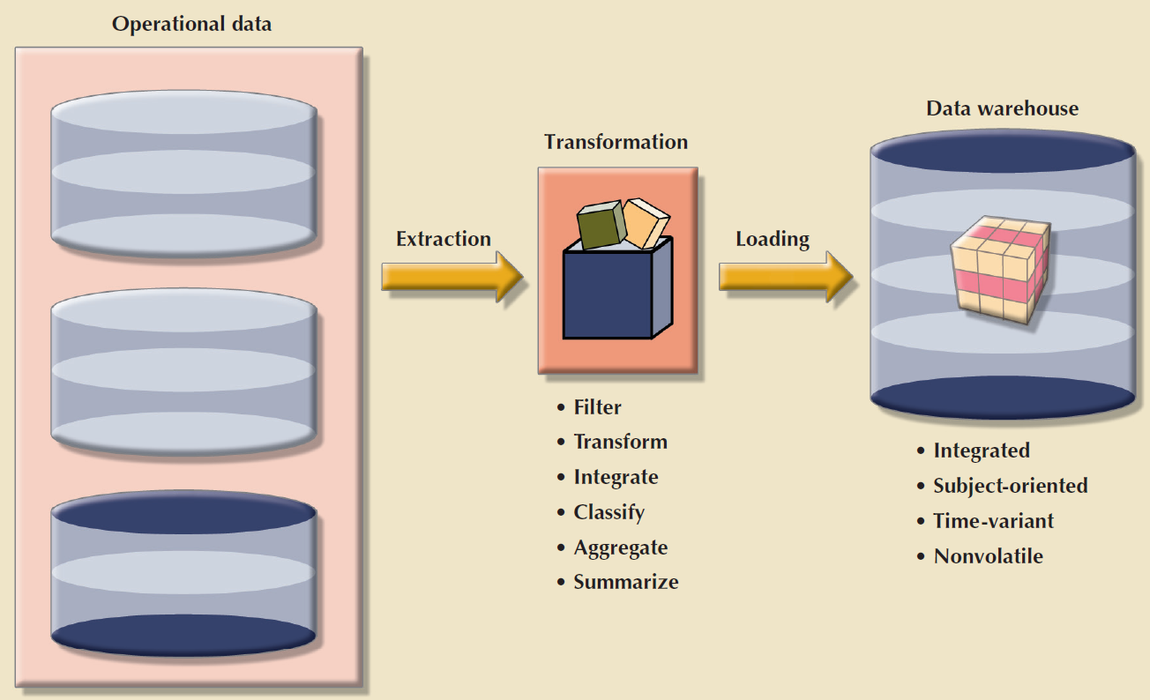
Figure 13.5 - The ETL Process
Cengage Learning © 2015

Slide 22
Data Marts
Small, single-subject data warehouse subset
Provide decision support to a small group of people
Benefits over data warehouses
Lower cost and shorter implementation time
Technologically advanced
Inevitable people issues

Slide 23
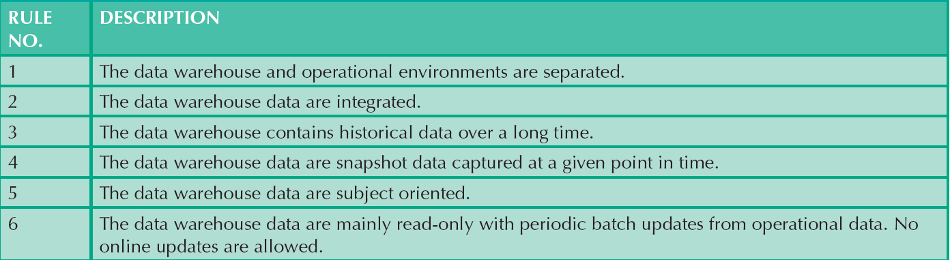
Table 13.9 - Twelve Rules for a Data Warehouse
Cengage Learning © 2015

Slide 24
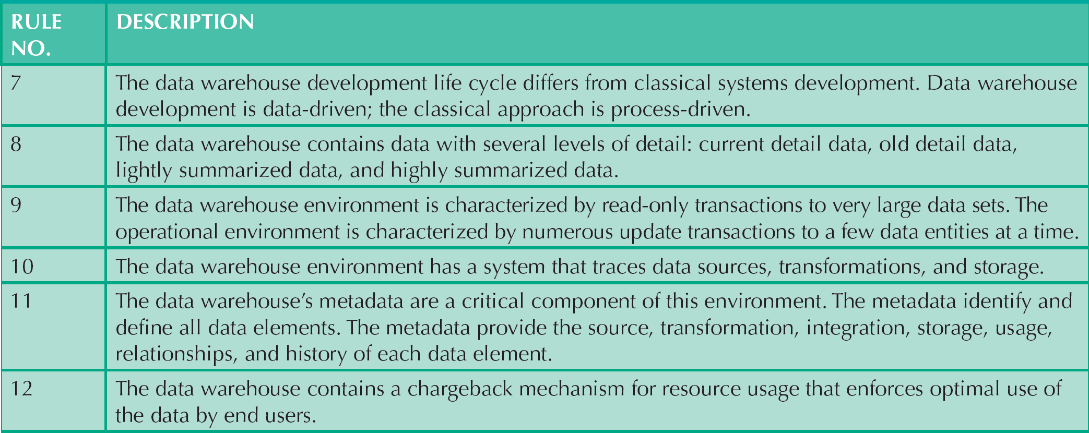
Table 13.9 - Twelve Rules for a Data Warehouse
Cengage Learning © 2015

Slide 25
Star Schema
Data-modeling technique
Maps multidimensional decision support data into a relational database
Creates the near equivalent of multidimensional database schema from existing relational database
Yields an easily implemented model for multidimensional data analysis

Slide 26
Components of Star Schemas
Facts
Dimensions
Attributes
Numeric values that represent a specific business aspect
Qualifying characteristics that provide additional perspectives to a given fact
Used to search, filter, and classify facts
Slice and dice: Ability to focus on slices of the data cube for more detailed analysis
Attribute hierarchy
Provides a top-down data organization

Slide 27
Star Schema Representation
Facts and dimensions represented by physical tables in data warehouse database
Many-to-one (M:1) relationship between fact table and each dimension table
Fact and dimension tables
Related by foreign keys
Subject to primary and foreign key constraints

Slide 28
Star Schema Representation
Primary key of a fact table
Is a composite primary key because the fact table is related to many dimension tables
Always formed by combining the foreign keys pointing to the related dimension tables

Slide 29
Techniques Used to Optimize Data Warehouse Design
Normalizing dimensional tables
Snowflake schema: Dimension tables can have their own dimension tables
Maintaining multiple fact tables to represent different aggregation levels
Denormalizing fact tables

Slide 30
Techniques Used to Optimize Data Warehouse Design
Partitioning and replicating tables
Partitioning: Splits tables into subsets of rows or columns and places them close to customer location
Replication: Makes copy of table and places it in a different location
Periodicity: Provides information about the time span of the data stored in the table

Slide 31
Data Analytics
Encompasses a wide range of mathematical, statistical, and modeling techniques to extract knowledge from data
Subset of BI functionality
Classification of tools
Explanatory analytics: Focuses on discovering and explaining data characteristics and relationships based on existing data
Predictive analytics: Focuses on predicting future outcomes with a high degree of accuracy

Slide 32
Data Mining
Analyzing massive amounts of data to:
Uncover hidden trends, patterns, and relationships
Form computer models to stimulate and explain the findings
Use the models to support business decision making
Run in two modes
Guided
Automated

Slide 33
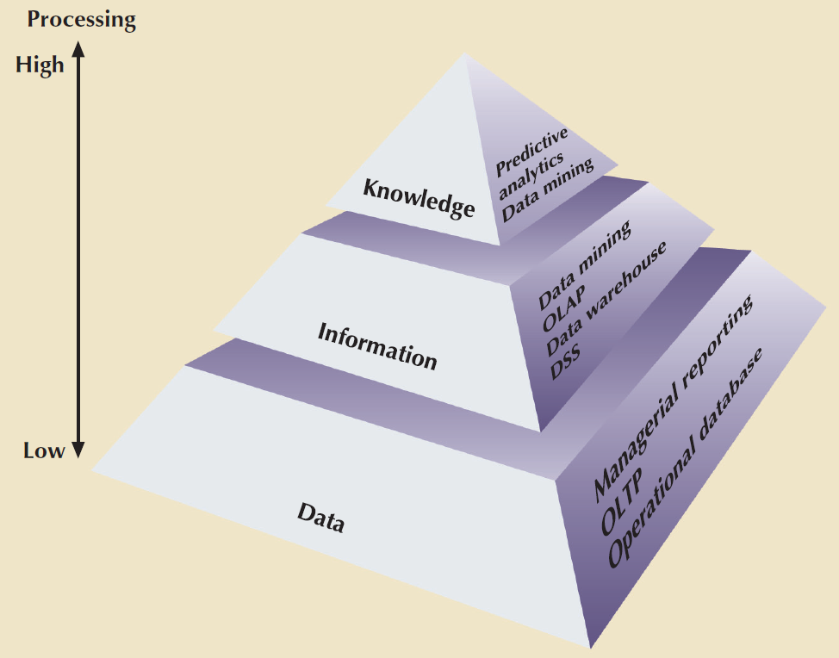
Figure 13. 15 - Extracting Knowledge from Data
Cengage Learning © 2015

Slide 34
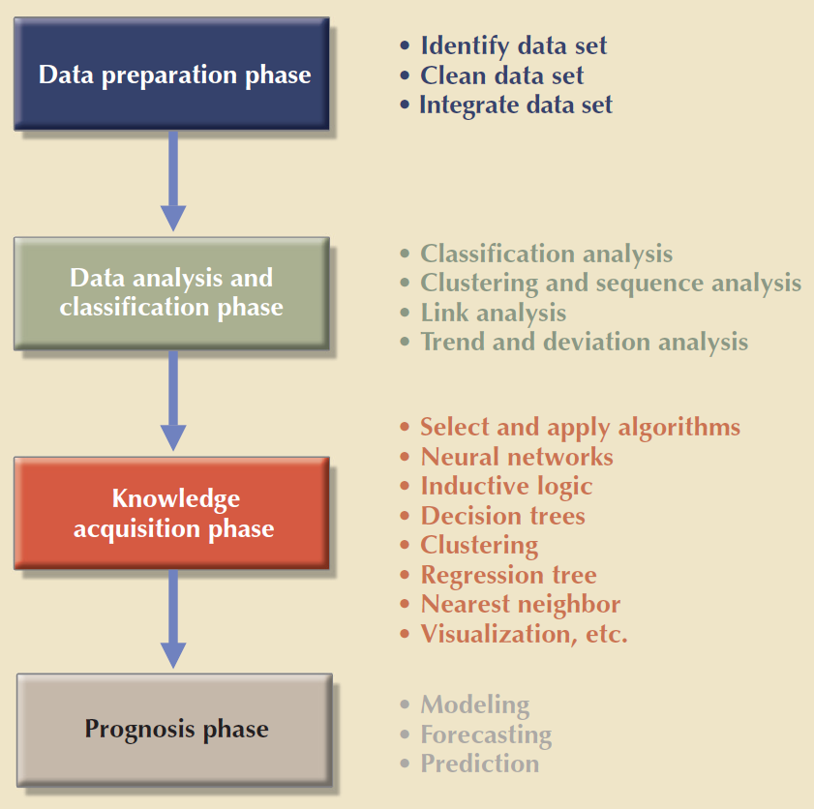
Figure 13. 16 - Data-Mining Phases
Cengage Learning © 2015

Slide 35
Predictive Analytics
Employs mathematical and statistical algorithms, neural networks, artificial intelligence, and other advanced modeling tools
Creates actionable predictive models based on available data
Next logical step after data mining
Adds value to an organization
Helps optimize the existing processes
Identify hidden problems
Anticipate future problems or opportunities

Slide 36
Online Analytical Processing
Advanced data analysis environment that supports decision making, business modeling, and operations research
Characteristics
Multidimensional data analysis techniques
Advanced database support
Easy-to-use end-user interfaces

Slide 37
Multidimensional Data Analysis Techniques
Data are processed and viewed as part of a multidimensional structure
Augmenting functions
Advanced data presentation functions
Advanced data aggregation, consolidation, and classification functions
Advanced computational functions
Advanced data-modeling functions

Slide 38
Advanced Database Support
Advanced data access features
Access to many different kinds of DBMSs, flat files, and internal and external data sources
Access to aggregated data warehouse data and to the detail data found in operational databases
Advanced data navigation features
Rapid and consistent query response times
Ability to map end-user requests to appropriate data source and to proper data access language
Support for very large databases

Slide 39
Easy-to-Use End-User Interface
Proper implementation leads to simple navigation and accelerated decision making or data analysis
Advanced OLAP features are more useful when access is kept simple
Many interface features are borrowed from previous generations of data analysis tools

Slide 40
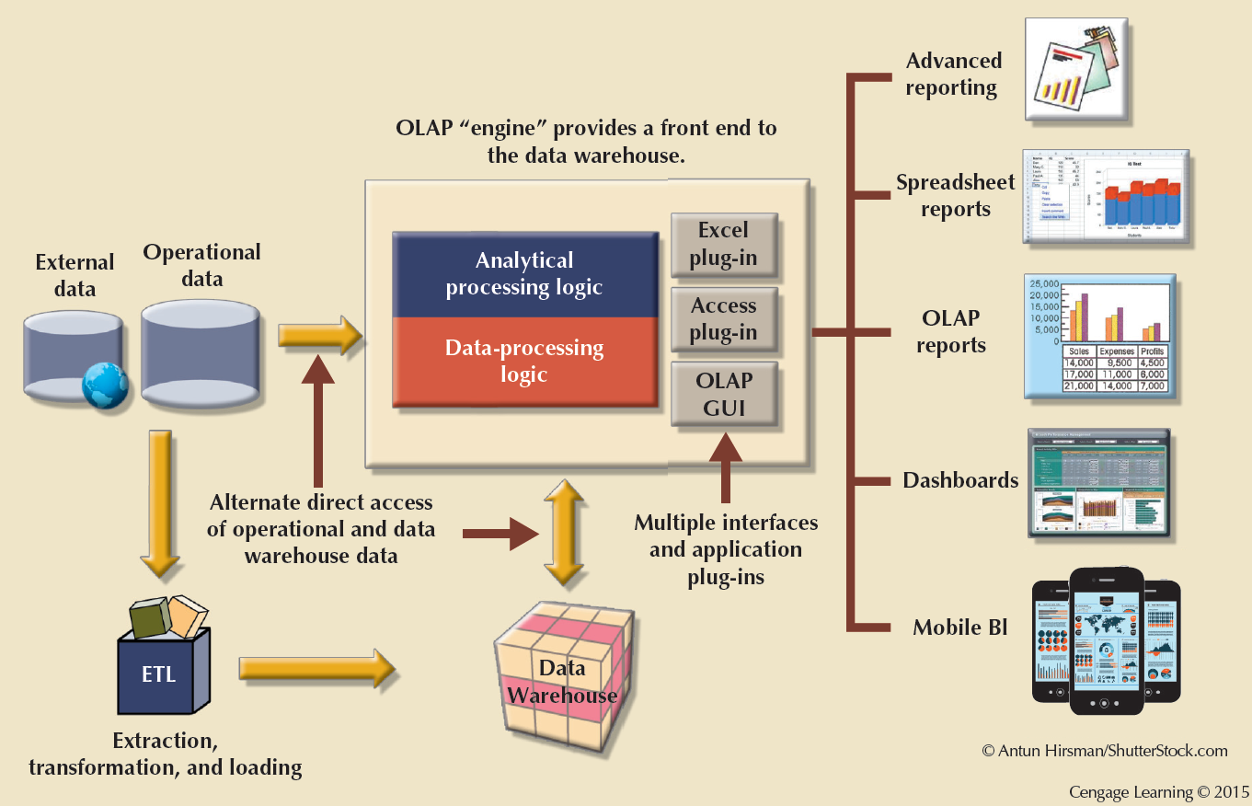
Figure 13.19 - OLAP Architecture

Slide 41
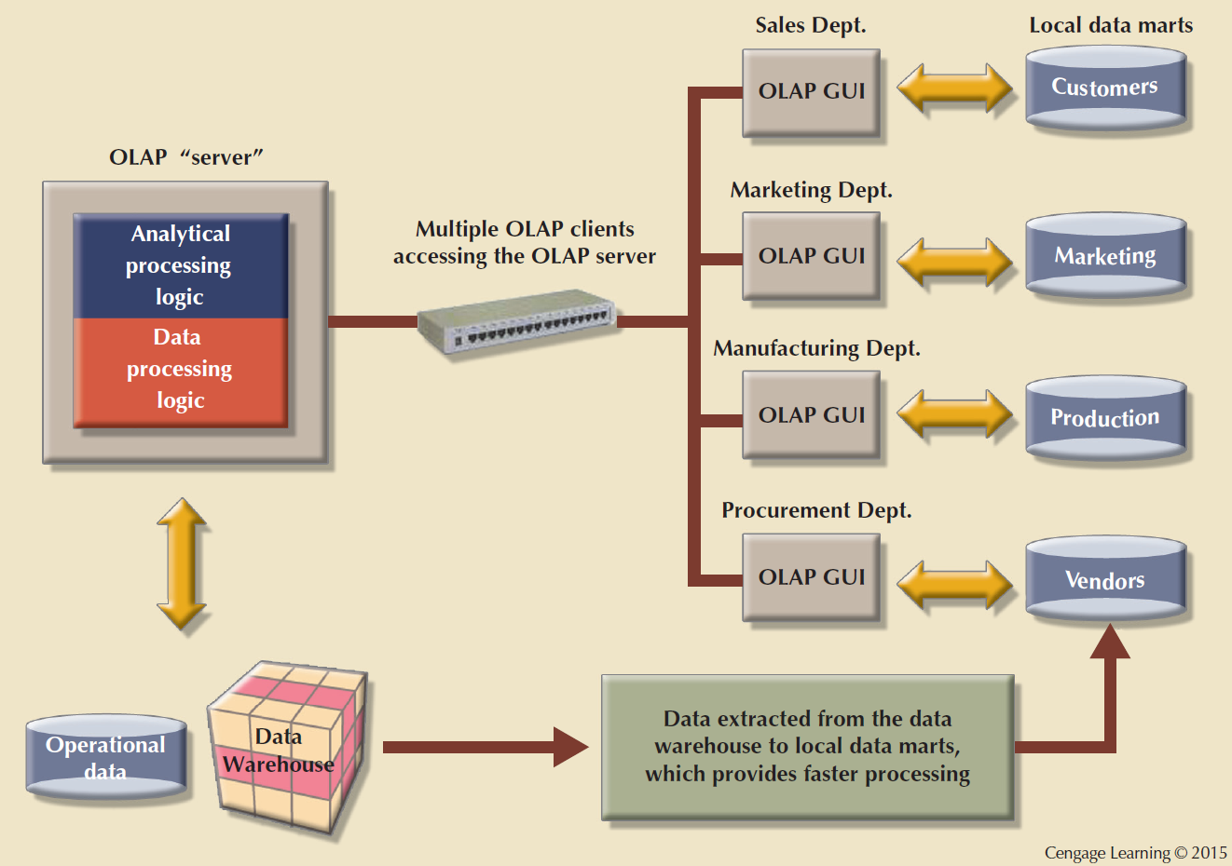
Figure 13.20 - OLAP Server with Local Miniature Data Marts

Slide 42

Relational Online Analytical Processing (ROLAP)
Provides OLAP functionality using relational databases and familiar relational tools to store and analyze multidimensional data
Extensions added to traditional RDBMS technology
Multidimensional data schema support within the RDBMS
Data access language and query performance optimized for multidimensional data
Support for very large databases (VLDBs)

Slide 43
Multidimensional Online Analytical Processing (MOLAP)
Extends OLAP functionality to multidimensional database management systems (MDBMSs)
MDBMS: Uses proprietary techniques store data in matrix-like n-dimensional arrays
End users visualize stored data as a 3D data cube
Grow to n dimensions, becoming hypercubes
Held in memory in a cube cache to speed access
Sparsity: Measures the density of the data held in the data cube

Slide 44
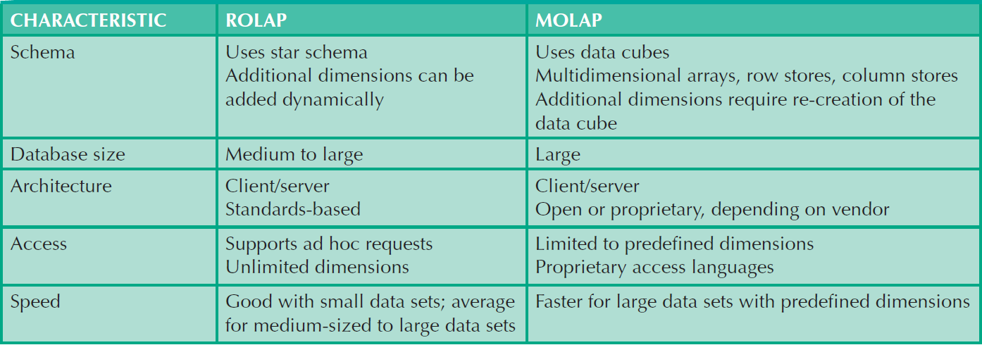
Table 13.12 - Relational vs. Multidimensional OLAP
Cengage Learning © 2015

Slide 45
SQL Extensions for OLAP
The ROLLUP extension
Used with GROUP BY clause to generate aggregates by different dimensions
Enables subtotal for each column listed except for the last one, which gets a grand total
Order of column list important
The CUBE extension
Used with GROUP BY clause to generate aggregates by the listed columns
Includes the last column

Slide 46
Materialized View
Dynamic table that contains SQL query command to generate rows and stores the actual rows
Created the first time query is run
Summary rows are stored in the table
Automatically updated when base tables are updated
Requires specified privileges

